Slide 1
Sliding HyperLogLog: Estimating cardinality in a data stream over a sliding window
A Project in Computer Science (234290/1)
Spring 2023
K. B.

Slide 2
Contents
The Count-Distinct problem
Applications
Naïve approach
Cardinality Estimators Concepts
LogLog algorithm
HyperLogLog algorithm
Sliding HyperLogLog algorithm

Slide 3
Introduction

Slide 4
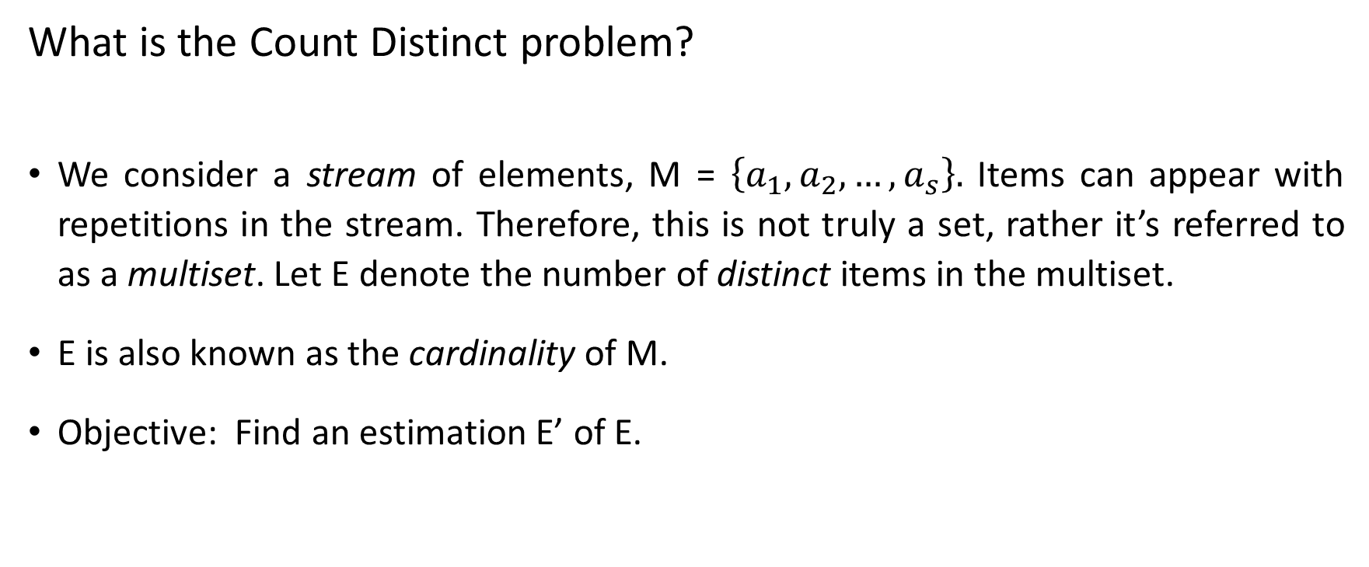
Introduction
What is the Count Distinct problem?
We consider a stream of elements, M = $\left\{a_{1},a_{2},…,a_{s}\right\}.$ Items can appear with repetitions in the stream. Therefore, this is not truly a set, rather it’s referred to as a multiset. Let E denote the number of distinct items in the multiset.
E is also known as the cardinality of M.
Objective: Find an estimation E’ of E.

Slide 5



Applications
Network and traffic monitoring:
- Detection of worm propagation, or networks attacks (e.g., DDoS)
- IP addresses of packets through a router
- Unique visitors of a website
Biological data:
- Motifs in DNA sequences
Databases
Natural language texts

Slide 6
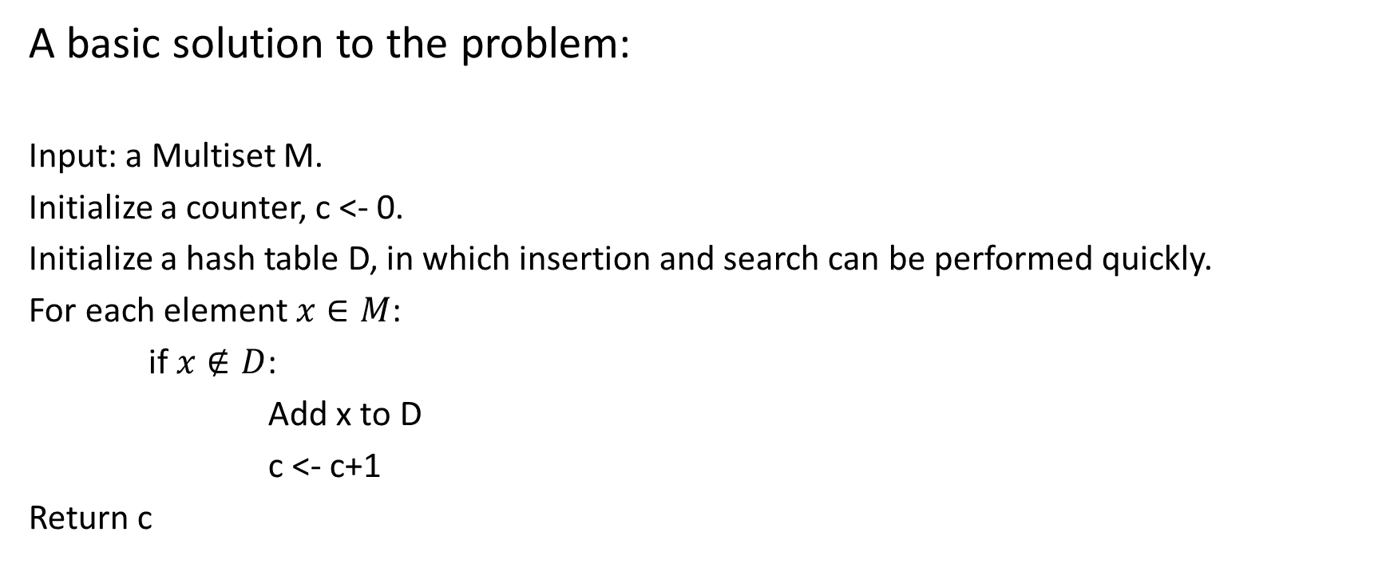
Naïve approach
A basic solution to the problem:
Input: a Multiset M.
Initialize a counter, c <- 0.
Initialize a hash table D, in which insertion and search can be performed quickly.
For each element $x∈M$:
if $x∉D$:
Add x to D
c <- c+1
Return c

Slide 7
Analysis
Correctness:
The algorithm creates a new set (a dictionary) and adds each unique item to it in case it was not found in the dictionary. Therefore, the size of the dictionary is equal to E, the number of distinct elements.
Complexity:
Assuming the multiset M has n elements: Each search and addition takes O(1) time, therefore the algorithm runs in O(n) time.
However, for each unique item, it is added to the dictionary therefore using more auxiliary space - the algorithm has O(n) space complexity!

Slide 8
Problems in naïve approach
The algorithm runs in O(n) time, but it uses too much auxiliary space, O(n). This is because it holds a list of past unique items in the stream. To calculate the stream cardinality, the items in the stream don’t matter as much, as the cardinality itself that matters!
A crucial idea is to relax the constraint in calculating the cardinality E exactly, and to develop probabilistic algorithms dedicated to estimating E approximately.
In many practical applications, a tolerance of a few percents on the results is acceptable, considering that the stream size is very large.

Slide 9
Cardinality Estimators Concepts

Slide 10
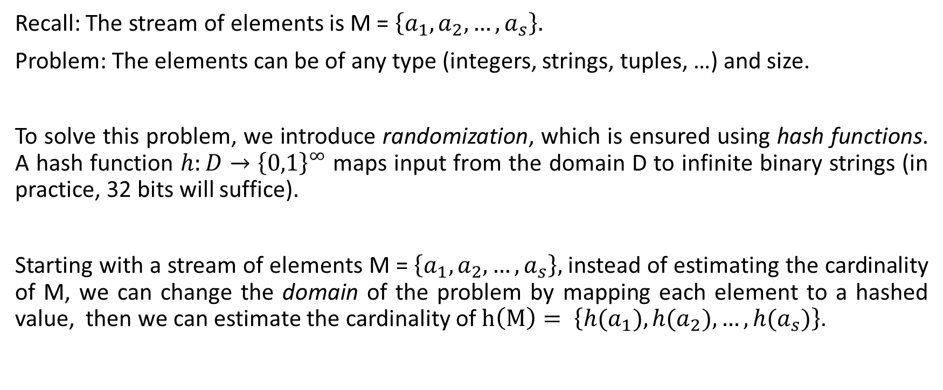
Randomness and Hashing
Recall: The stream of elements is M = $\left\{a_{1},a_{2},…,a_{s}\right\}.$
Problem: The elements can be of any type (integers, strings, tuples, …) and size.
To solve this problem, we introduce randomization, which is ensured using hash functions. A hash function $h:{D→\left\{0,1\right\}}^{∞}$ maps input from the domain D to infinite binary strings (in practice, 32 bits will suffice).
Starting with a stream of elements M = $\left\{a_{1},a_{2},…,a_{s}\right\},$ instead of estimating the cardinality of M, we can change the domain of the problem by mapping each element to a hashed value, then we can estimate the cardinality of $h\left(M\right)= \left\{h(a_{1}),h(a_{2}),…,h(a_{s})\right\}$.

Slide 11
Randomness and Hashing
A ‘good’ hash function should be designed in a way that the hashed values closely resemble a uniform model of randomness: each bit in the result has a ½ probability of occurring. In practice we would want a very small probability for collisions.
Practical hash functions exist, for example sha1/256, or functions based on CRC’s, modular arithmetics and more.
When hashing the multiset M to h(M) using a ‘good’ hash function, we can assume that no collisions would occur: the E distinct elements of M will map to E distinct hashed values. Therefore, h(M) will have the same cardinality of M!

Slide 12
Categories of cardinality estimators
Bit pattern observables:
These are based on observing certain patterns of bits occurring at the beginning of the (binary) words in h(M), and the probabilities of those patterns appearing. The LogLog family is in this category.
Order statistics observables:
These are based on interpreting hashed values as real numbers in the range [0,1]. For instance, if X = Min(h(M)), n is roughly of the order of 1/X (since E(X)=1/n+1). The MinCount algorithm is in this category for example.

Slide 13
The LogLog Algorithm

Slide 14

Experiment: Flipping a coin
Let’s discuss a simple coin flipping game. We flip a coin. As long as the result is (H), we keep flipping until we get our first (T), then we stop.
By playing this game repeatedly, we get many coin sequences of different sizes, for example:
H T
H H T
T
H H H T
We notice that the probability of getting a certain streak decreases for longer streaks. For example, the probability of getting a streak of length 4 (last streak in example) is 1/16.
Another way to interpret this probability: for 16 attempts, on average one sequence will be 3 Heads and a Tail!

Slide 15
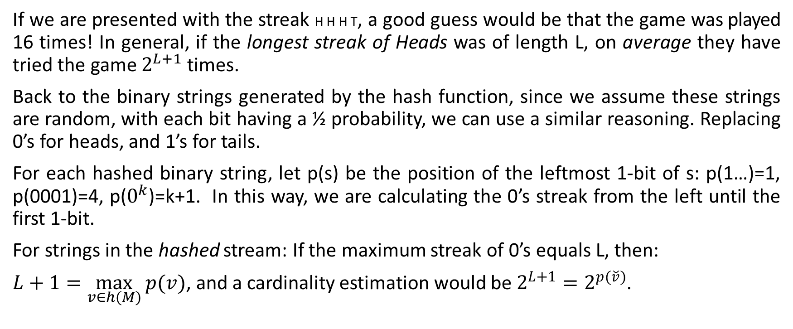
Coins and Binary Strings
If we are presented with the streak H H H T, a good guess would be that the game was played 16 times! In general, if the longest streak of Heads was of length L, on average they have tried the game $2^{L+1}$ times.
Back to the binary strings generated by the hash function, since we assume these strings are random, with each bit having a ½ probability, we can use a similar reasoning. Replacing 0’s for heads, and 1’s for tails.
For each hashed binary string, let p(s) be the position of the leftmost 1-bit of s: p(1…)=1, p(0001)=4, p($0^{k}$)=k+1. In this way, we are calculating the 0’s streak from the left until the first 1-bit.
For strings in the hashed stream: If the maximum streak of 0’s equals L, then:
$L+1=\max_{v∈h(M)}{p(v)}$, and a cardinality estimation would be $2^{L+1}=2^{p(\check{v})}$.

Slide 16
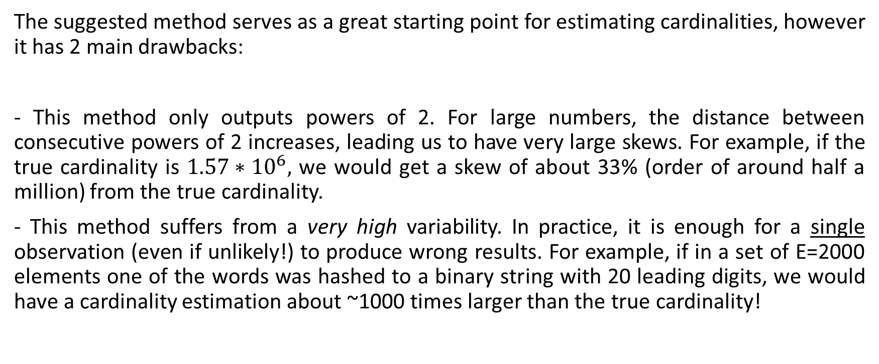
Drawbacks
The suggested method serves as a great starting point for estimating cardinalities, however it has 2 main drawbacks:
- This method only outputs powers of 2. For large numbers, the distance between consecutive powers of 2 increases, leading us to have very large skews. For example, if the true cardinality is ${1.57∗10}^{6},$ we would get a skew of about 33% (order of around half a million) from the true cardinality.
- This method suffers from a very high variability. In practice, it is enough for a single observation (even if unlikely!) to produce wrong results. For example, if in a set of E=2000 elements one of the words was hashed to a binary string with 20 leading digits, we would have a cardinality estimation about ~1000 times larger than the true cardinality!

Slide 17
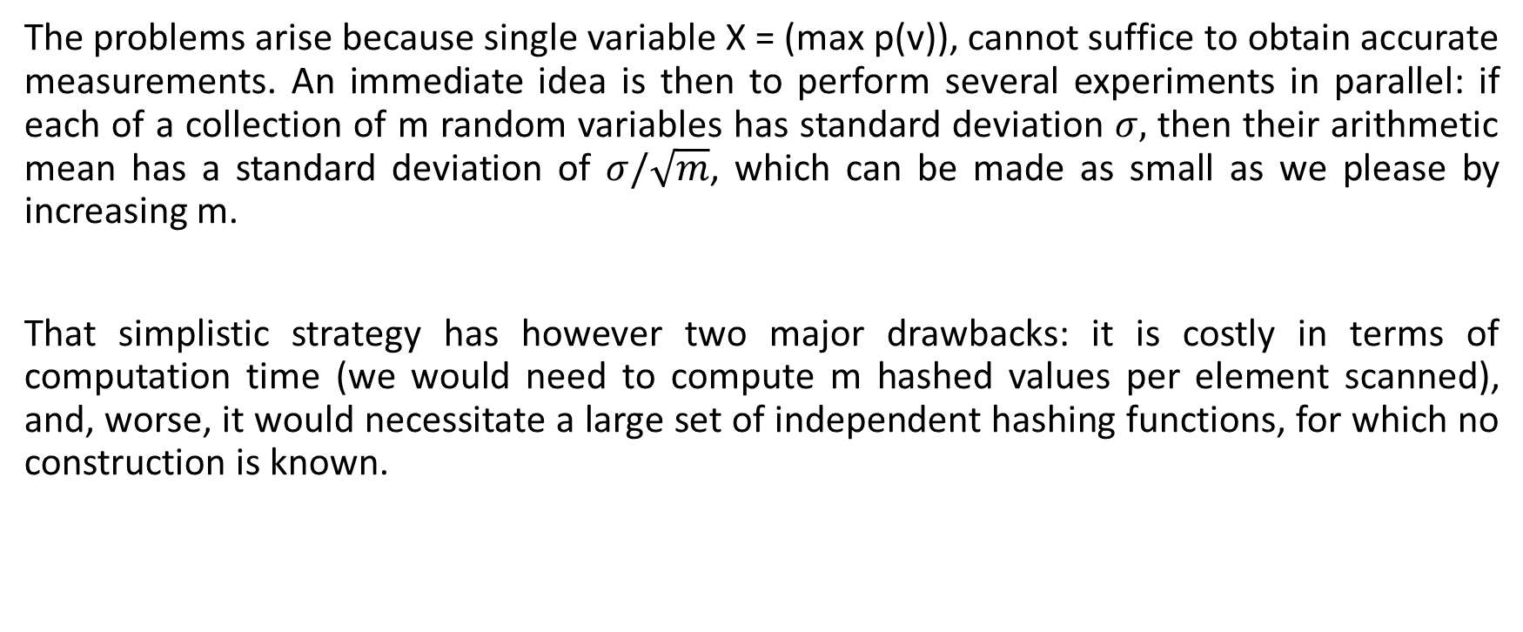
Attempted solution
The problems arise because single variable X = (max p(v)), cannot suffice to obtain accurate measurements. An immediate idea is then to perform several experiments in parallel: if each of a collection of m random variables has standard deviation $σ,$ then their arithmetic mean has a standard deviation of $σ/\sqrt{m}$, which can be made as small as we please by increasing m.
That simplistic strategy has however two major drawbacks: it is costly in terms of computation time (we would need to compute m hashed values per element scanned), and, worse, it would necessitate a large set of independent hashing functions, for which no construction is known.

Slide 18
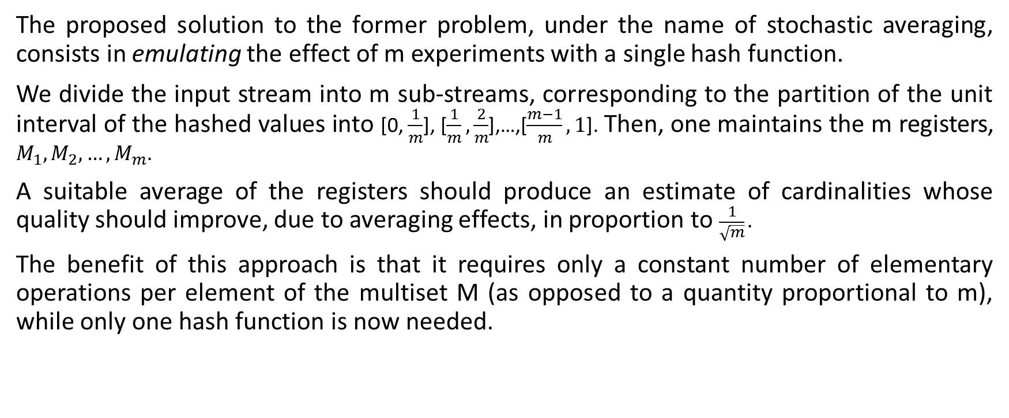
Stochastic Averaging
The proposed solution to the former problem, under the name of stochastic averaging, consists in emulating the effect of m experiments with a single hash function.
We divide the input stream into m sub-streams, corresponding to the partition of the unit interval of the hashed values into [0, $\frac{1}{m}$], [$\frac{1}{m},\frac{2}{m}$],…,[$\frac{m−1}{m}, 1$]. Then, one maintains the m registers, $M_{1},M_{2},…,M_{m}.$
A suitable average of the registers should produce an estimate of cardinalities whose quality should improve, due to averaging effects, in proportion to $\frac{1}{\sqrt{m}}.$
The benefit of this approach is that it requires only a constant number of elementary operations per element of the multiset M (as opposed to a quantity proportional to m), while only one hash function is now needed.

Slide 19
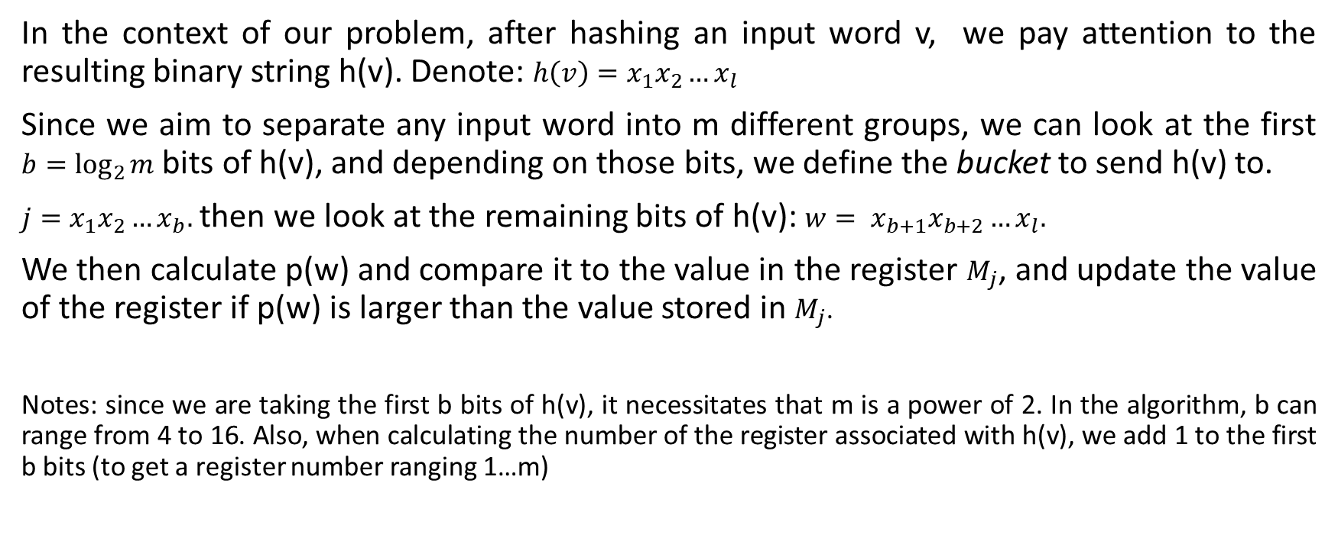
Buckets
In the context of our problem, after hashing an input word v, we pay attention to the resulting binary string h(v). Denote: ${h\left(v\right)=x}_{1}x_{2}…x_{l}$
Since we aim to separate any input word into m different groups, we can look at the first $b=\log_{2}{m}$ bits of h(v), and depending on those bits, we define the bucket to send h(v) to.
${j=x}_{1}x_{2}…x_{b}.$ then we look at the remaining bits of h(v): ${w= x}_{b+1}x_{b+2}…x_{l}.$
We then calculate p(w) and compare it to the value in the register $M_{j}$, and update the value of the register if p(w) is larger than the value stored in $M_{j}$.
Notes: since we are taking the first b bits of h(v), it necessitates that m is a power of 2. In the algorithm, b can range from 4 to 16. Also, when calculating the number of the register associated with h(v), we add 1 to the first b bits (to get a register number ranging 1…m)

Slide 20
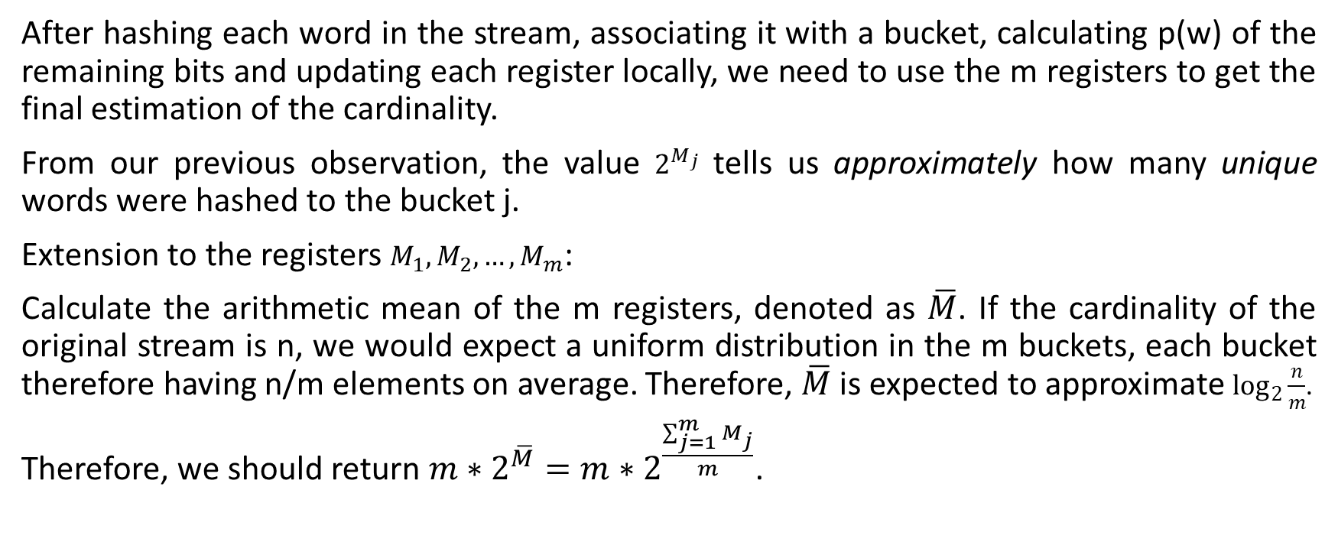
Cardinality Estimation
After hashing each word in the stream, associating it with a bucket, calculating p(w) of the remaining bits and updating each register locally, we need to use the m registers to get the final estimation of the cardinality.
From our previous observation, the value $2^{M_{j}}$ tells us approximately how many unique words were hashed to the bucket j.
Extension to the registers $M_{1},M_{2},…,M_{m}$:
Calculate the arithmetic mean of the m registers, denoted as $\overline{M}$. If the cardinality of the original stream is n, we would expect a uniform distribution in the m buckets, each bucket therefore having n/m elements on average. Therefore, $\overline{M}$ is expected to approximate $\log_{2}{\frac{n}{m}}$.
Therefore, we should return $m∗2^{\overline{M}}=m∗2^{\frac{\sum_{j=1}^{m}{M_{j}}}{m}}$.

Slide 21
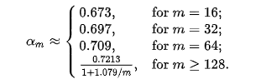

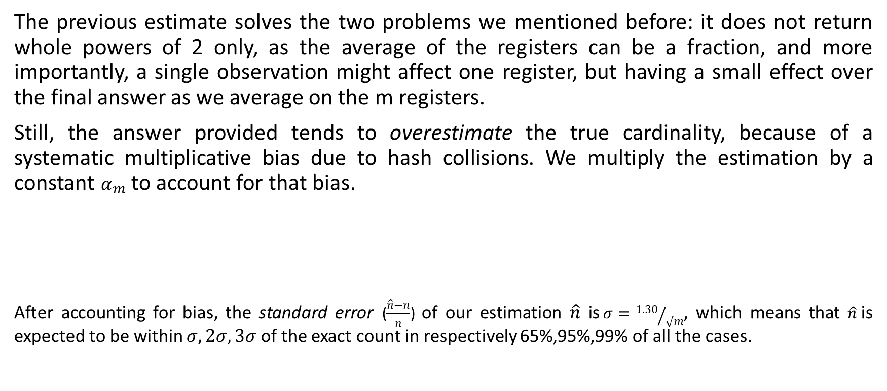
Accounting for bias
The previous estimate solves the two problems we mentioned before: it does not return whole powers of 2 only, as the average of the registers can be a fraction, and more importantly, a single observation might affect one register, but having a small effect over the final answer as we average on the m registers.
Still, the answer provided tends to overestimate the true cardinality, because of a systematic multiplicative bias due to hash collisions. We multiply the estimation by a constant $α_{m}$ to account for that bias.
After accounting for bias, the standard error ($\frac{\hat{n}−n}{n}$) of our estimation $\hat{n}$ is$σ={1.30}/{\sqrt{m}}$, which means that $\hat{n}$is expected to be within $σ,2σ,3σ$ of the exact count in respectively 65%,95%,99% of all the cases.

Slide 22
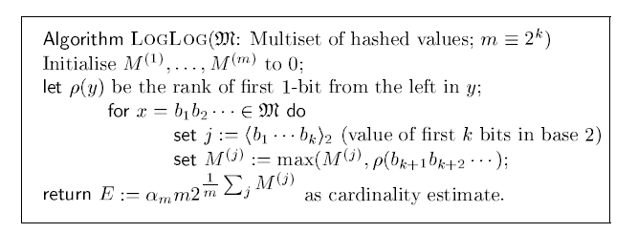

Recap
Below is the pseudo-code for the LogLog algorithm. It includes the main ideas we’ve discussed so far:
Hashing, Observing bit patterns, Usage of buckets, and Bias correction.
Note: in practice, the LogLog algorithm might be run on different servers simultaneously. To merge 2 LL’s, we obtain the maximum for each pair of registers j: 1 … m

Slide 23
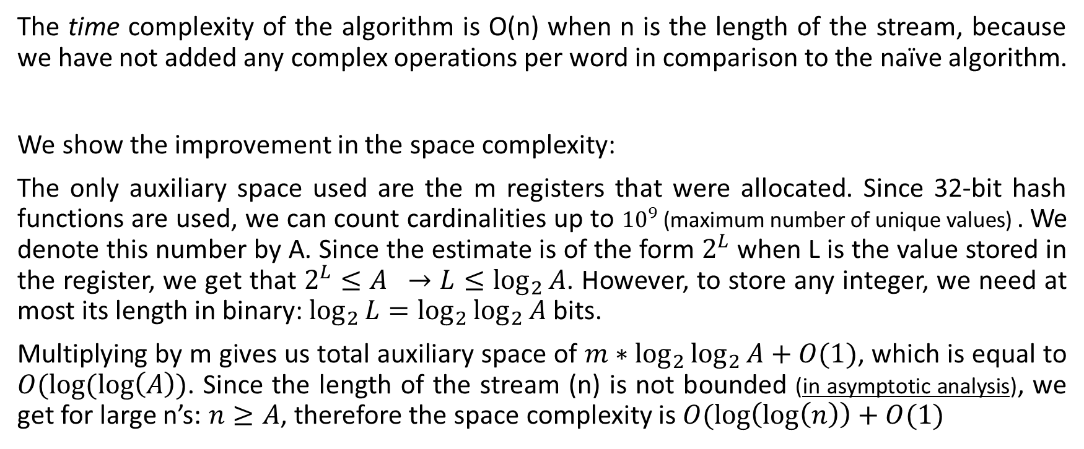
Space Complexity
The time complexity of the algorithm is O(n) when n is the length of the stream, because we have not added any complex operations per word in comparison to the naïve algorithm.
We show the improvement in the space complexity:
The only auxiliary space used are the m registers that were allocated. Since 32-bit hash functions are used, we can count cardinalities up to ${10}^{9}$ (maximum number of unique values) . We denote this number by A. Since the estimate is of the form $2^{L}$ when L is the value stored in the register, we get that $2^{L}≤A →L≤\log_{2}{A}$. However, to store any integer, we need at most its length in binary: $\log_{2}{L}=\log_{2}{\log_{2}{A}}$ bits.
Multiplying by m gives us total auxiliary space of $m∗\log_{2}{\log_{2}{A}}+O(1)$, which is equal to $O(log⁡(\log\left(A\right))$. Since the length of the stream (n) is not bounded (in asymptotic analysis), we get for large n’s: $n≥A$, therefore the space complexity is $O(\log\left(\log\left(n\right)\right)+O(1)$
Notes:
Note that since we truncate the first b=log2(m) bits, each hashed word will have at most 32-b bits.
Therefore in practice we estimate cardinalities up to 2^(32-b) = 2^32/m (or A/m if applicable ..)

Slide 24
The HyperLogLog Algorithm

Slide 25
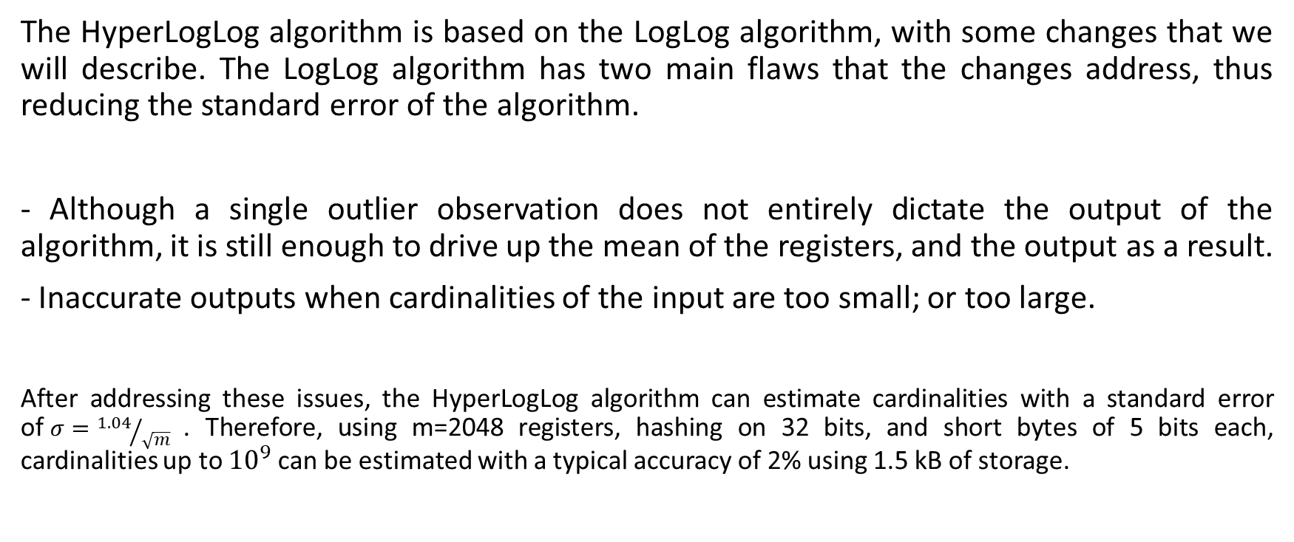
Further Improvements
The HyperLogLog algorithm is based on the LogLog algorithm, with some changes that we will describe. The LogLog algorithm has two main flaws that the changes address, thus reducing the standard error of the algorithm.
- Although a single outlier observation does not entirely dictate the output of the algorithm, it is still enough to drive up the mean of the registers, and the output as a result.
- Inaccurate outputs when cardinalities of the input are too small; or too large.
After addressing these issues, the HyperLogLog algorithm can estimate cardinalities with a standard error of$σ={1.04}/{\sqrt{m}}$ . Therefore, using m=2048 registers, hashing on 32 bits, and short bytes of 5 bits each, cardinalities up to ${10}^{9}$ can be estimated with a typical accuracy of 2% using 1.5 kB of storage.

Slide 26
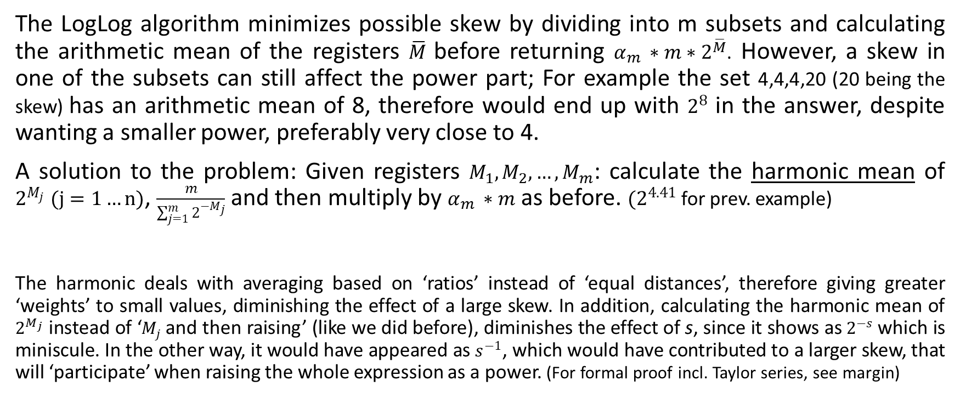
Cardinality Estimation: Revisited
The LogLog algorithm minimizes possible skew by dividing into m subsets and calculating the arithmetic mean of the registers $\overline{M}$ before returning $α_{m} ∗m∗2^{\overline{M}}$. However, a skew in one of the subsets can still affect the power part; For example the set 4,4,4,20 (20 being the skew) has an arithmetic mean of 8, therefore would end up with $2^{8}$ in the answer, despite wanting a smaller power, preferably very close to 4.
A solution to the problem: Given registers $M_{1},M_{2},…,M_{m}$: calculate the harmonic mean of $2^{M_{j}} (j=1…n)$, $\frac{m}{\sum_{j=1}^{m}{2^{{−M}_{j}}}}$ and then multiply by $α_{m} ∗m$ as before. $(2^{4.41}$ for prev. example)
The harmonic deals with averaging based on ‘ratios’ instead of ‘equal distances’, therefore giving greater ‘weights’ to small values, diminishing the effect of a large skew. In addition, calculating the harmonic mean of $2^{M_{j}}$ instead of ‘$M_{j}$ and then raising’ (like we did before), diminishes the effect of s, since it shows as $2^{−s}$ which is miniscule. In the other way, it would have appeared as $s^{−1}$, which would have contributed to a larger skew, that will ‘participate’ when raising the whole expression as a power. (For formal proof incl. Taylor series, see margin)
Notes:
To estimate the effect of a skew, we take m registers each one having value x, then we replace one by x << s, and compare the cardinality to check how much it increases in each case.
-Harmonic mean of 2^Mj: in the denominator, we add the term d1=(2^-s) – (2^-x) which is negative. If 2^s is extremely small this is almost the equivalent of dropping one register from the denominator (i.e. summing j=1…m-1 but keeping m in the numerator) result:(multiplying (original answer=2^x) by (m/m-1)).
-Harmonic mean of Mj then power: in the denominator we add the term d2 = (1/s)-(1/x) which is negative. We look at its contribution in the harmonic mean: we can use maclaurin series of 1/t, calculate up to first power of t. then multiply by the numerator (m). -> (1+(1-(m/x)))*m. we raise 2 to the power of that.
We do that again when adding d2 -> maclaurin series of 1/d2+x . After accounting, and raising: 2 ^(1+(1-(m/x)-d))*m
The new expression = the old * 2^(-d*m). (-d*m >0 therefore 2^(-d*m) > 1).
Summing up: the harmonic mean of 2^Mj method increased by m/m-1 , other method by 2^(-d*m) when d=(1/s-1/x)<0
Multiplying we get:
(m-1)*2^(-d)*2^(m) > m
This is because –d >0 -> 2^(-d) > 1 , also: 2^m > m for all m, or can brute force m’s in the algorithm and we get the equality

Slide 27
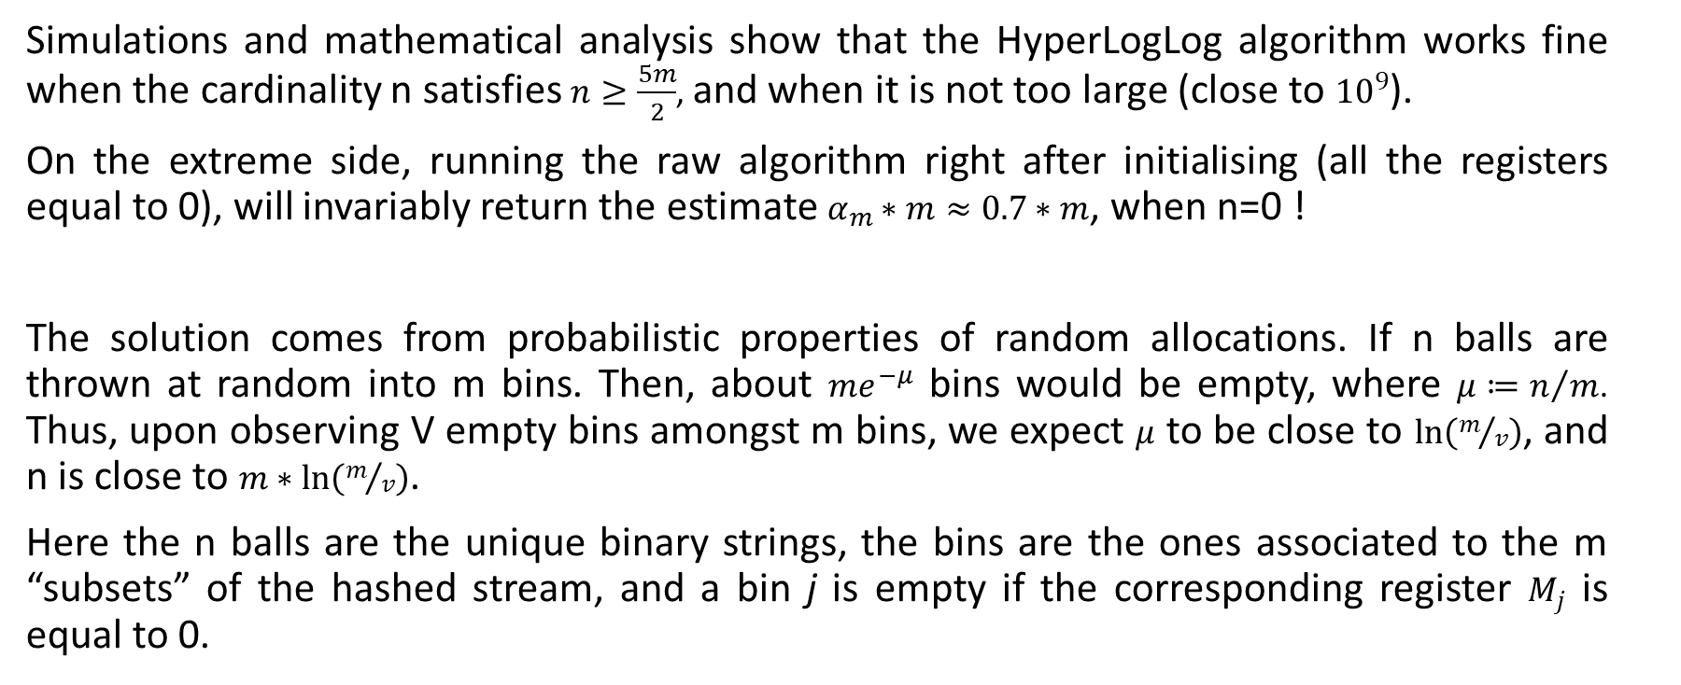
Small Range Corrections
Simulations and mathematical analysis show that the HyperLogLog algorithm works fine when the cardinality n satisfies $n≥\frac{5m}{2}$, and when it is not too large (close to ${10}^{9}$).
On the extreme side, running the raw algorithm right after initialising (all the registers equal to 0), will invariably return the estimate $α_{m}∗m≈0.7∗m$, when n=0 !
The solution comes from probabilistic properties of random allocations. If n balls are thrown at random into m bins. Then, about $me^{−μ}$ bins would be empty, where $μ≔n/m$. Thus, upon observing V empty bins amongst m bins, we expect $μ$ to be close to $\ln\left(m/v\right)$, and n is close to $m∗\ln\left(m/v\right)$.
Here the n balls are the unique binary strings, the bins are the ones associated to the m “subsets” of the hashed stream, and a bin j is empty if the corresponding register $M_{j}$ is equal to 0.

Slide 28
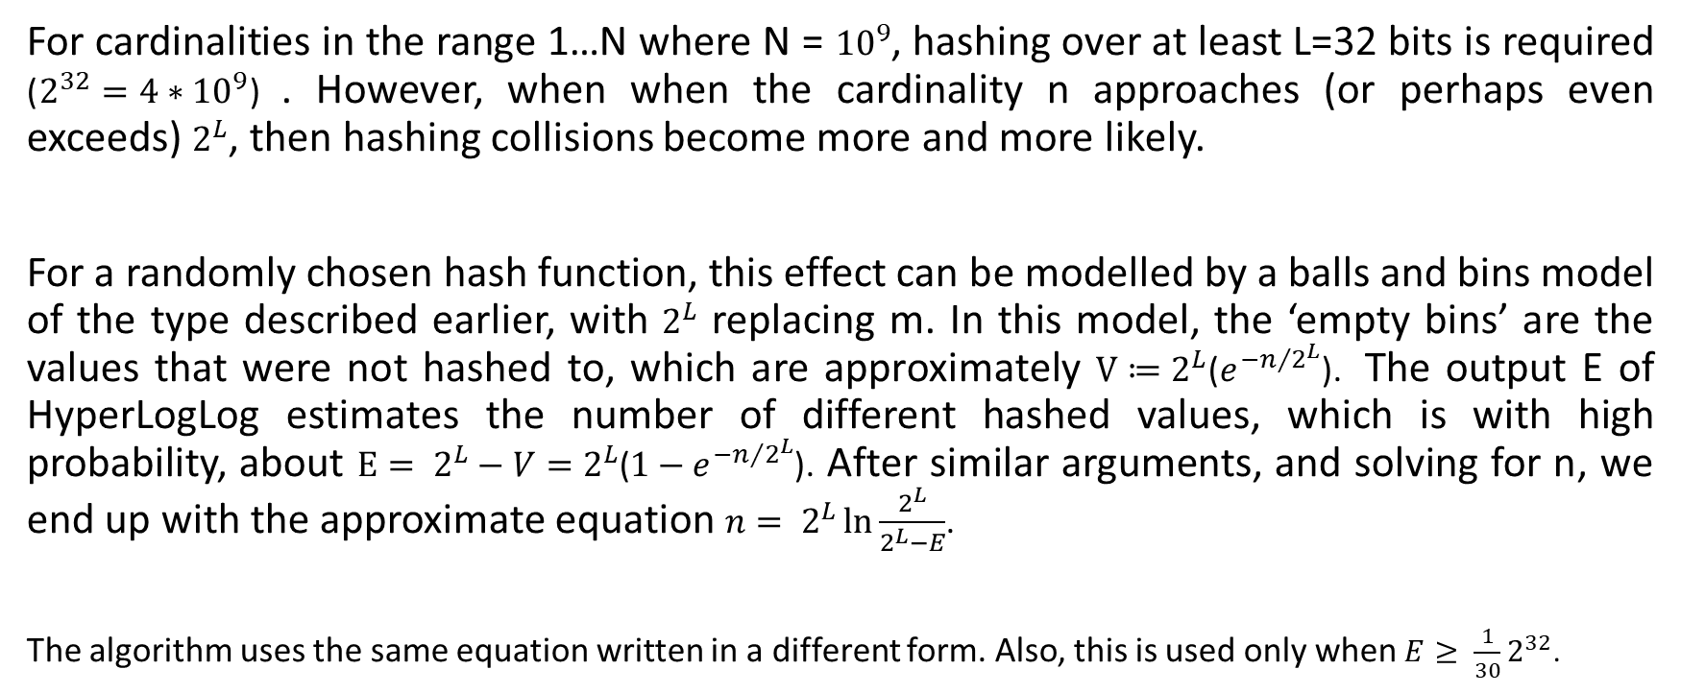
Large Range Correlations
For cardinalities in the range 1…N where N = ${10}^{9}$, hashing over at least L=32 bits is required ($2^{32}=4∗{10}^{9}$) . However, when when the cardinality n approaches (or perhaps even exceeds) $2^{L}$, then hashing collisions become more and more likely.
For a randomly chosen hash function, this effect can be modelled by a balls and bins model of the type described earlier, with $2^{L}$ replacing m. In this model, the ‘empty bins’ are the values that were not hashed to, which are approximately $V≔2^{L}$($e^{{−n}/{2^{L}}}$). The output E of HyperLogLog estimates the number of different hashed values, which is with high probability, about $E= 2^{L}−V=2^{L}$($1−e^{−n/{2^{L}}}$). After similar arguments, and solving for n, we end up with the approximate equation $n= 2^{L}\ln{\frac{2^{L}}{2^{L}−E}}$.
The algorithm uses the same equation written in a different form. Also, this is used only when $E≥ \frac{1}{30}2^{32}$.

Slide 29
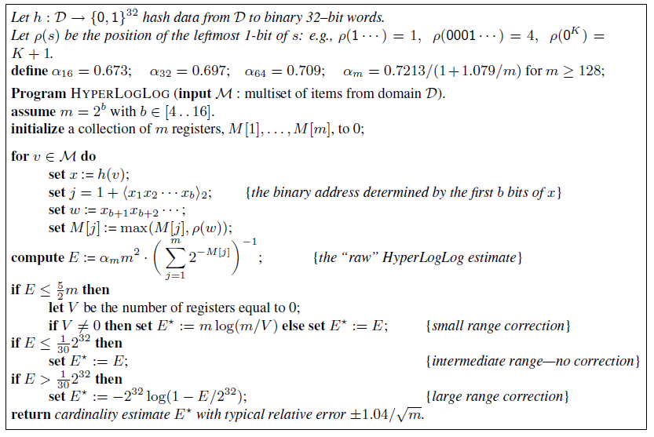
Recap
Pseudo-code for the HyperLogLog algorithm:

Slide 30
The Sliding HyperLogLog Algorithm

Slide 31
Static to Dynamic
The HyperLogLog algorithm, and other probabilistic algorithms are designed to perform on a static set of data: a given fixed traffic! So, they can not be applied to an infinite data stream. Moreover, for many network applications, we are mostly interested in traffic characteristics in the near past (few minutes ago for attacks detection).
A natural way to adapt these algorithms to data stream is to use the sliding window model. The objective is to be able to answer the following query at any time “How may distinct flows have been seen over the last w unit of time?” for any duration w smaller than the time window size W.
The proposed Sliding HyperLogLog algorithm maintains the same accuracy as in HyperLogLog, with a small additional required memory. In practice, with an additional memory of only 35kB, a standard error of about 3% can be achieved for a data stream of several million flows.

Slide 32
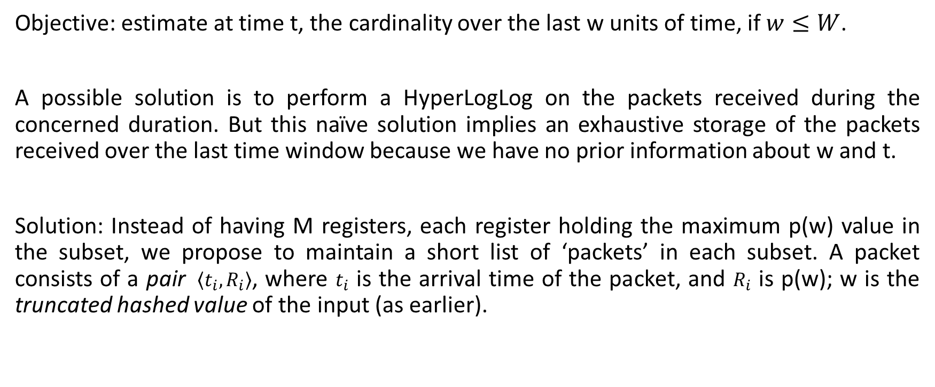
Adaptation
Objective: estimate at time t, the cardinality over the last w units of time, if $w≤W$.
A possible solution is to perform a HyperLogLog on the packets received during the concerned duration. But this naïve solution implies an exhaustive storage of the packets received over the last time window because we have no prior information about w and t.
Solution: Instead of having M registers, each register holding the maximum p(w) value in the subset, we propose to maintain a short list of ‘packets’ in each subset. A packet consists of a pair $〈t_{i},R_{i}〉$, where $t_{i}$ is the arrival time of the packet, and $R_{i}$ is p(w); w is the truncated hashed value of the input (as earlier).

Slide 33
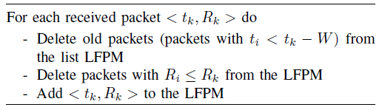

LFPM’s
The idea is to store only packets that are useful for the computation of the crucial parameter R, which is the largest value of Ri. A packet is stored only if it is a possible maximum over a future window of time. The list of stored packets is called List of Future Possible Maxima (LFPM). It is updated in the following way:
Note that each LFPM is a strictly decreasing list in terms of R. That is because for each two tuples $〈t_{i},R_{i}〉 ,〈t_{k},R_{k}〉$, the following condition is met: $R_{i}>R_{k} ⟺ t_{i}< t_{k}$

Slide 34
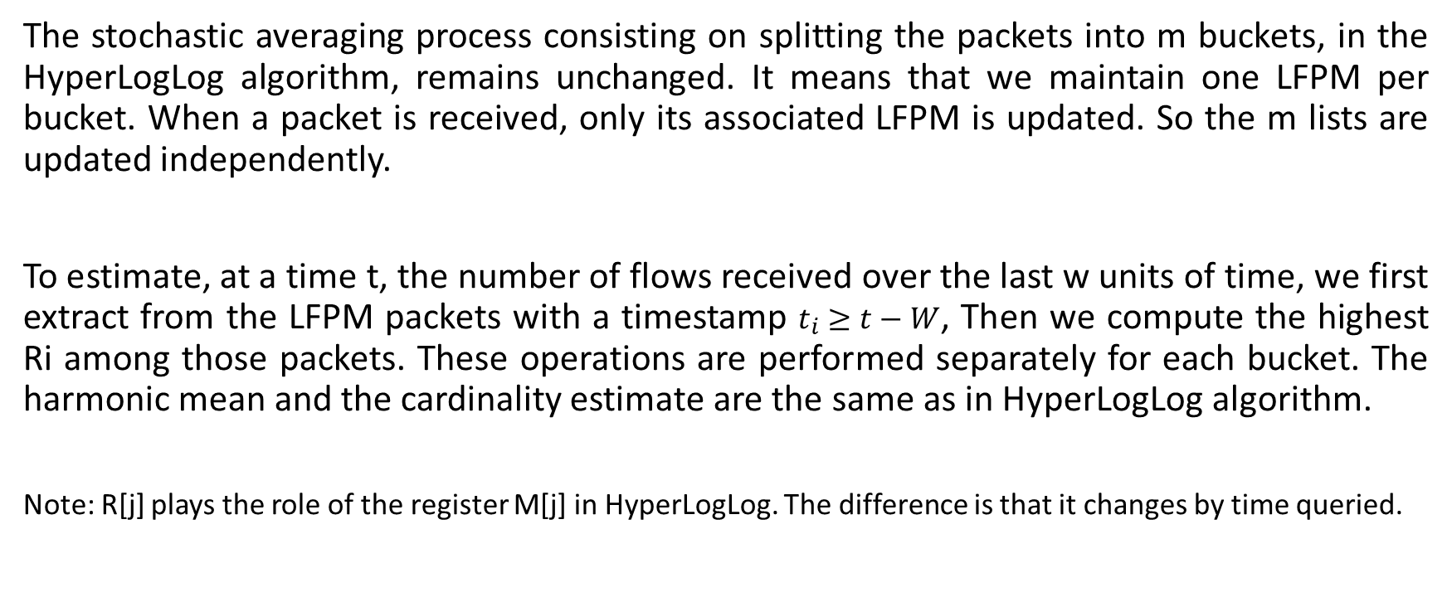
Cardinality Estimation
The stochastic averaging process consisting on splitting the packets into m buckets, in the HyperLogLog algorithm, remains unchanged. It means that we maintain one LFPM per bucket. When a packet is received, only its associated LFPM is updated. So the m lists are updated independently.
To estimate, at a time t, the number of flows received over the last w units of time, we first extract from the LFPM packets with a timestamp $t_{i}≥t−W$, Then we compute the highest Ri among those packets. These operations are performed separately for each bucket. The harmonic mean and the cardinality estimate are the same as in HyperLogLog algorithm.
Note: R[j] plays the role of the register M[j] in HyperLogLog. The difference is that it changes by time queried.
Notes:
An interesting consequence of the LFPM’s being of finite list (bounded by log(A)) and decreasing R’s, is that when merging shll_1,shll_2,…,shll_n:
It is more efficient to merge (shll_1,shll_2), then (shll_1,shll_3),…,(shll_1,shll_n) than if we merges the n shll’s all at once.
This is because when merging, even if the two lists were very long (close to A), the resulting LFPM will have a max length of A by construction,
(not 2*A as we would expect when merging normal lists)
Further elaboration in the code section

Slide 35
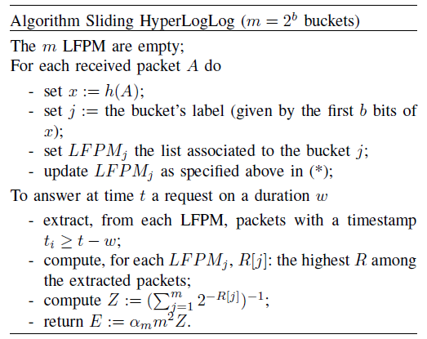
Recap
Pseudo-code for the Sliding HyperLogLog algorithm:

Slide 36
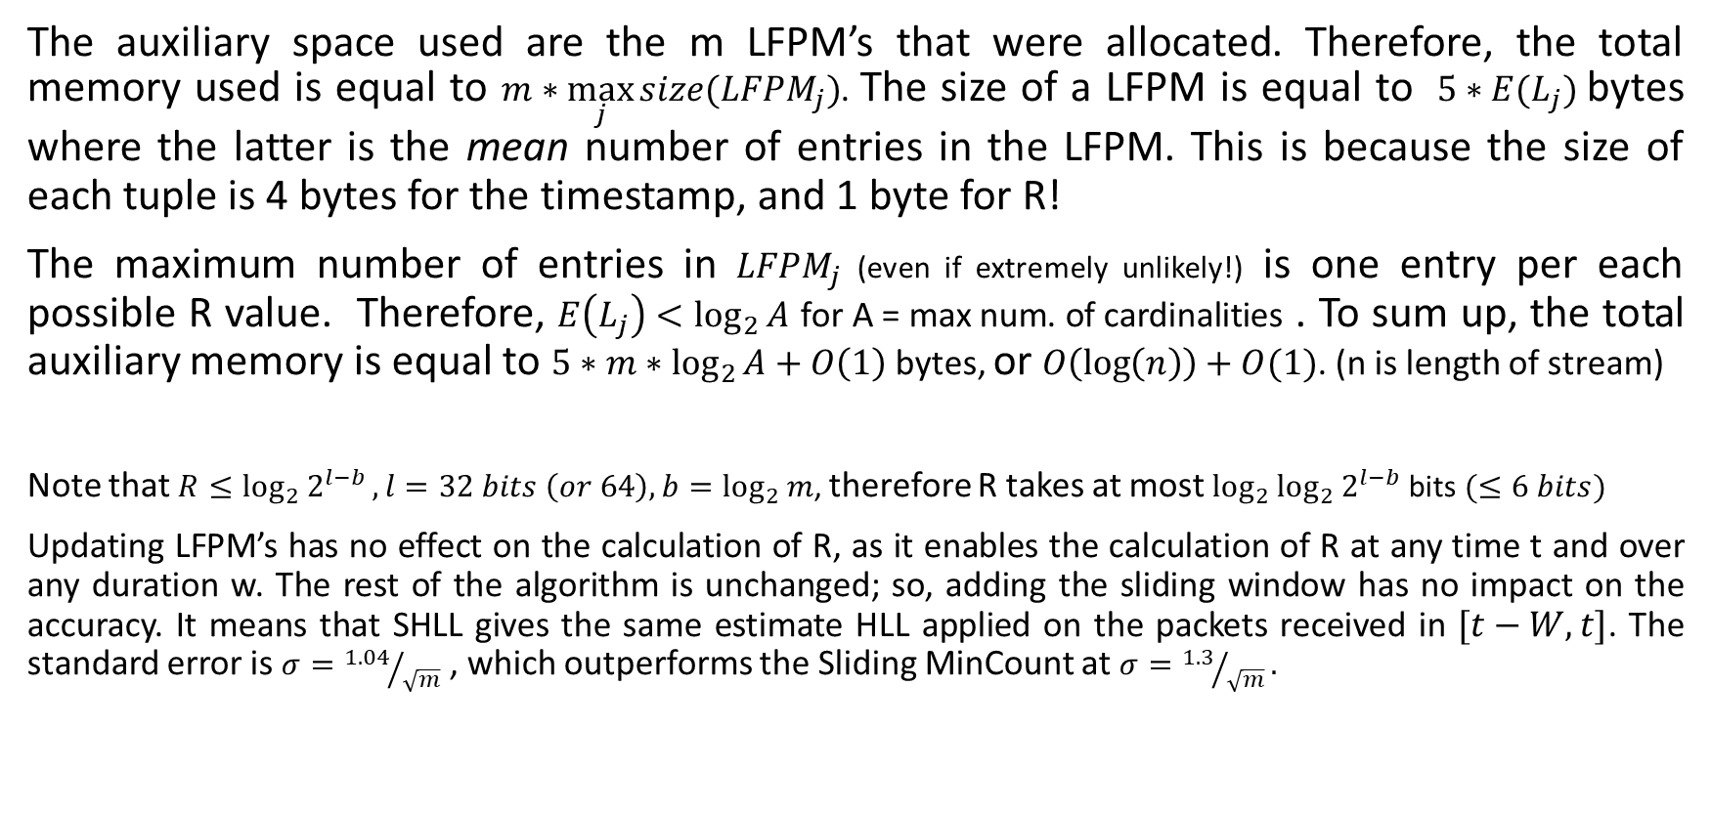
Memory Usage
The auxiliary space used are the m LFPM’s that were allocated. Therefore, the total memory used is equal to $m∗\max_{j}{size({LFPM}_{j})}$. The size of a LFPM is equal to $5∗E(L_{j})$ bytes where the latter is the mean number of entries in the LFPM. This is because the size of each tuple is 4 bytes for the timestamp, and 1 byte for R!
The maximum number of entries in ${LFPM}_{j}$ (even if extremely unlikely!) is one entry per each possible R value. Therefore, $E\left(L_{j}\right)<\log_{2}{A}$ for A = max num. of cardinalities . To sum up, the total auxiliary memory is equal to $5∗m∗\log_{2}{A}+O\left(1\right)$ bytes, or $O\left(\log\left(n\right)\right)+O(1)$. (n is length of stream)
Note that$R≤\log_{2}{2^{l−b}}, l=32 bits \left(or 64\right), b=\log_{2}{m}$, therefore R takes at most $\log_{2}{\log_{2}{2^{l−b}}}$ bits $(≤6 bits)$
Updating LFPM’s has no effect on the calculation of R, as it enables the calculation of R at any time t and over any duration w. The rest of the algorithm is unchanged; so, adding the sliding window has no impact on the accuracy. It means that SHLL gives the same estimate HLL applied on the packets received in $[t−W,t]$. The standard error is $σ={1.04}/{\sqrt{m}}$ , which outperforms the Sliding MinCount at $σ={1.3}/{\sqrt{m}}.$
Notes:
Since the length of the stream (n) is not bounded (in asymptotic analysis), we get for large n’s: $n≥A$ which is why we wrote n
Instead of A in E(Ln) < log2(A). (A: the max. number of cardinalities/hashed vals…)
Explanation for R equation line: the largest number we (in theory) can get after hashing is 2^L (2^32 for 32 bit hashes). Therefore, R, which holds p(w), a count
Of zeros, is at most the length of w! (max. *length* of w = l since we hash into l bits (e.g. 32)).
that since we truncate the first b=log2(m) bits, each hashed word will have at most 32-b=l-b bits.
Note that the real number of flows, n, which is closely related to the size of the time window, has no impact on the standard error.

Slide 37
Thanks for watching!

